Slide 1

TRANSFORMING LIVELIHOODS: JOBS
Global Economic Trends (GET)
Master in Management (MIM)
29th September 2022

Slide 2
The global labour market today

Slide 3
Low and declining labour force participation
Source: ILOSTAT (2021)

Slide 4
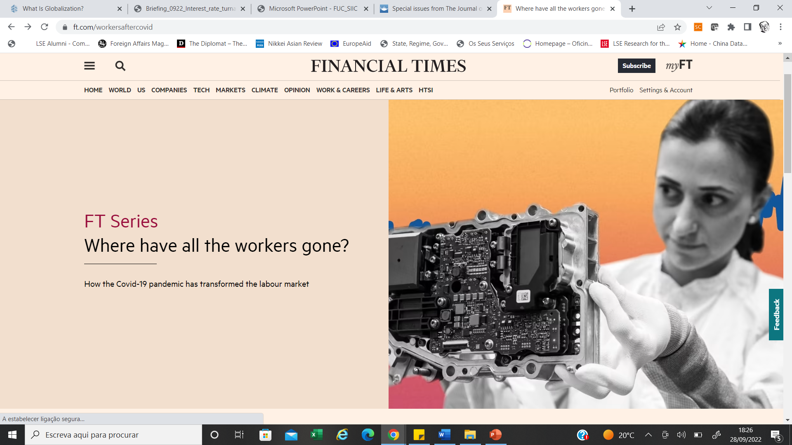

Slide 5
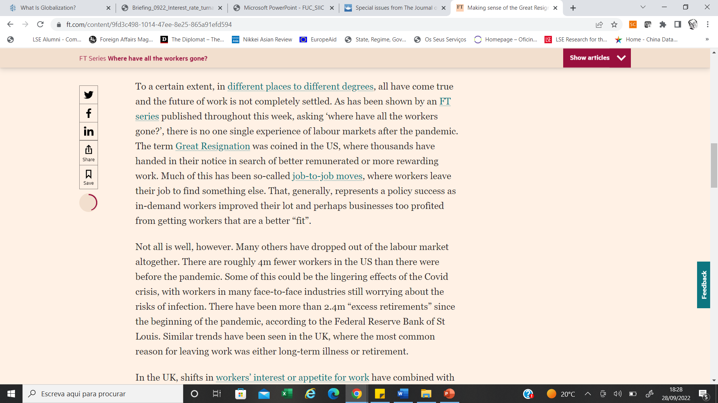

Slide 6
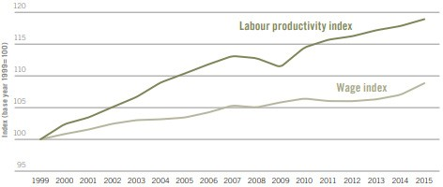
Wages stagnating compared to productivity
Trends in growth in average real wages and labour productivity in developed economies, 1999–2015
ILO Global wage report 2016/2017

Slide 7
The Post-1980s New Class System
Since 1980, the global economy has undergone a dramatic
transformation, with the globalization of the labor force, the rise of
automation, and—above all—the growth of Big Finance, Big Pharma,
and Big Tech. The social democratic consensus of the immediate
postwar years has given way to a new phase of capitalism that is
leaving workers further behind and reshaping the class structure. The
precariat, a mass class defined by unstable labor arrangements, lack
of identity, and erosion of rights, is emerging as today’s “dangerous
class.”
Guy Standing

Slide 9
THE NEW CLASS SYSTEM
Elite -» plutocracy or oligarchy striding the world with their billions—global citizens without responsibilities to any nation state. They are the top 0.001 percent.
Elite -»Possesses millions.
Old salaried class:
  the salariat, with strong employment security and an array of non-wage forms of remuneration
  the proficians, includes small-scale businesses, consists of workers who are project-oriented, entrepreneurial, multi-skilled, and likely to suffer from burn-out sooner or later.

Slide 10
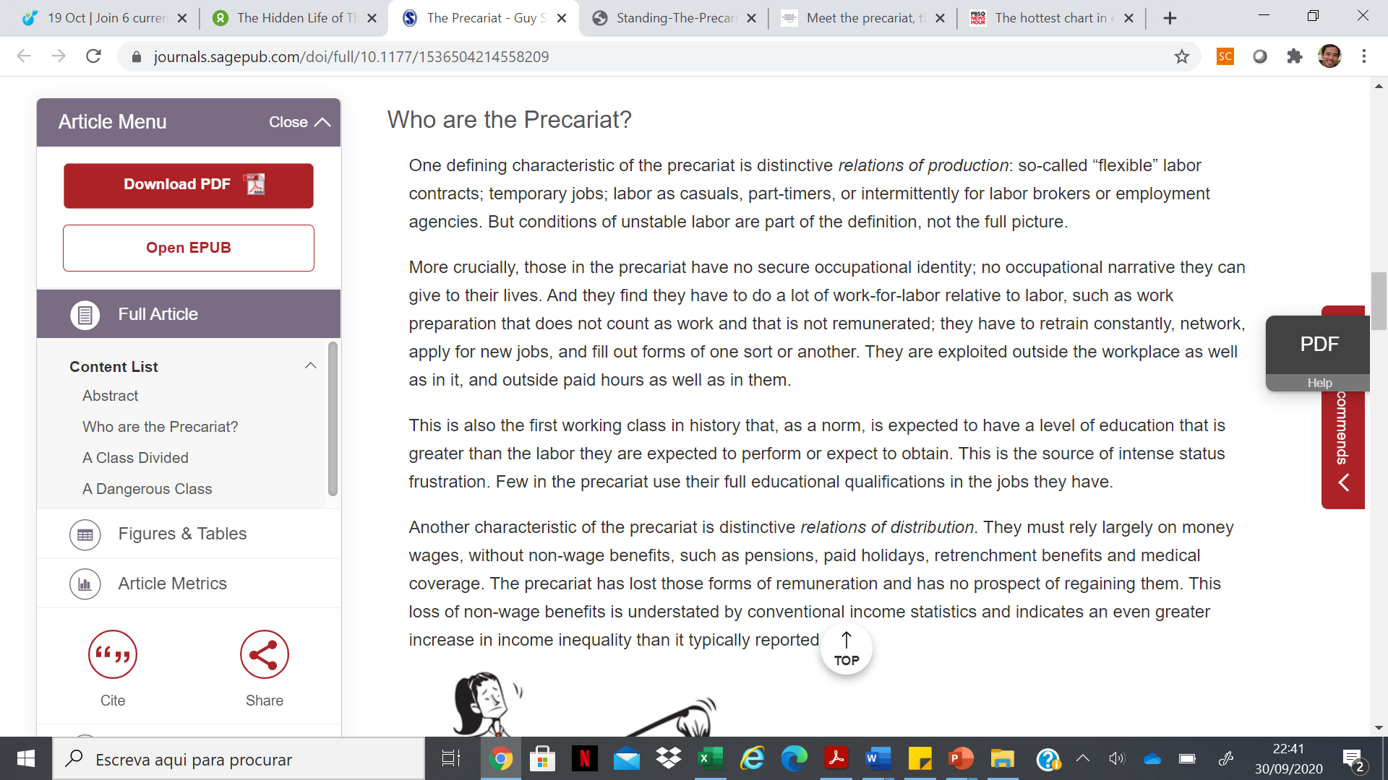


Slide 11
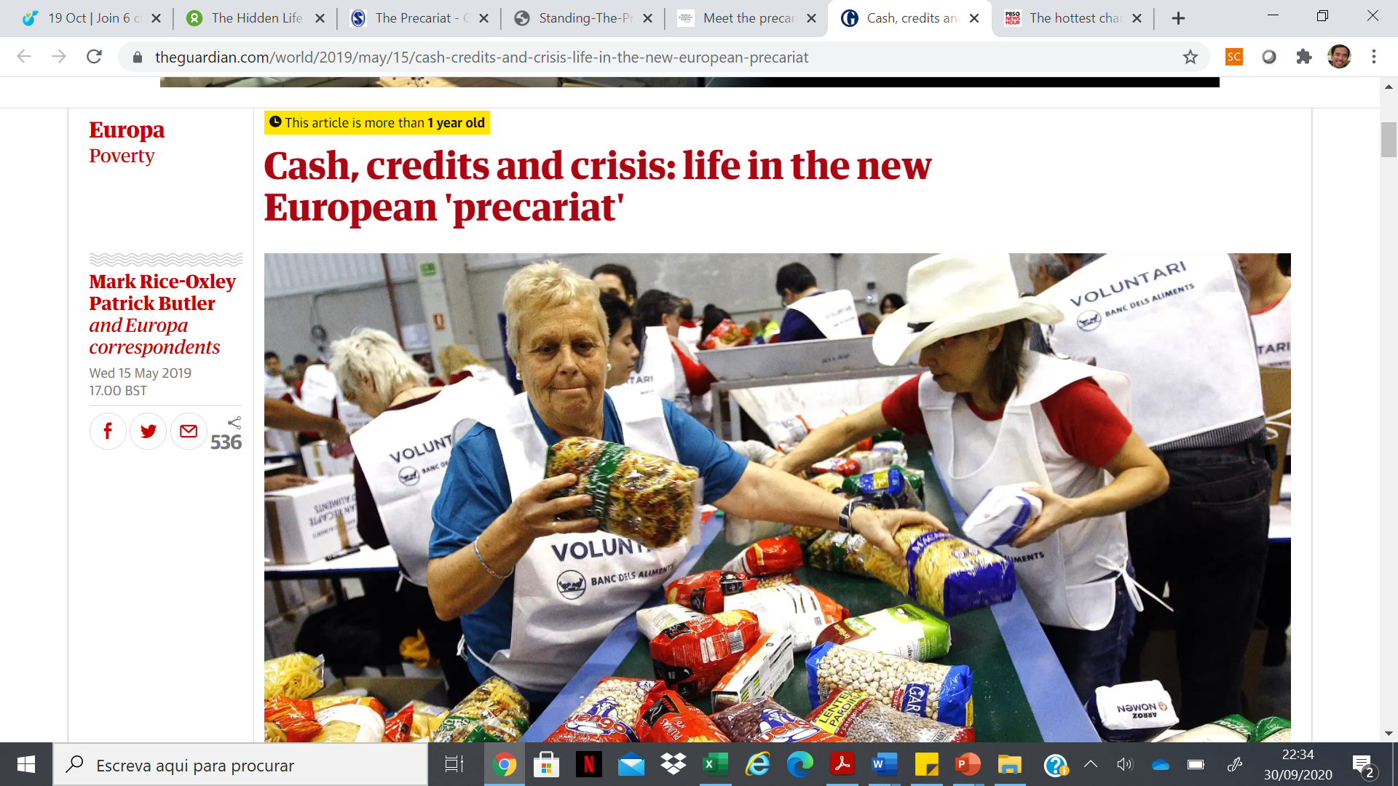

Slide 12
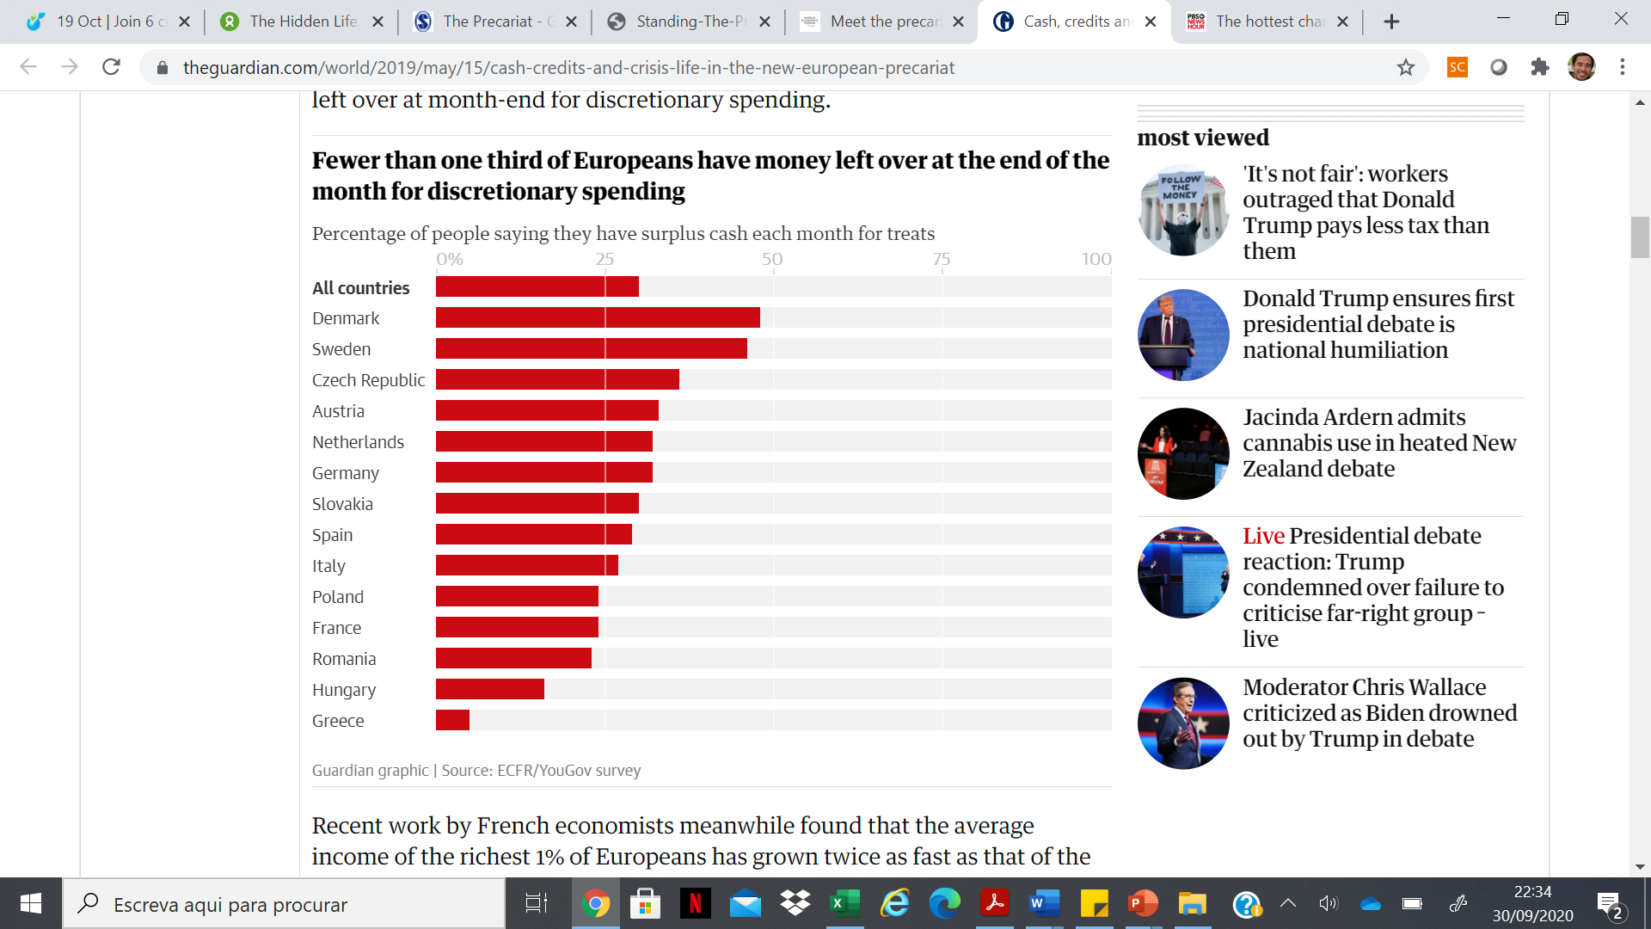

Slide 13
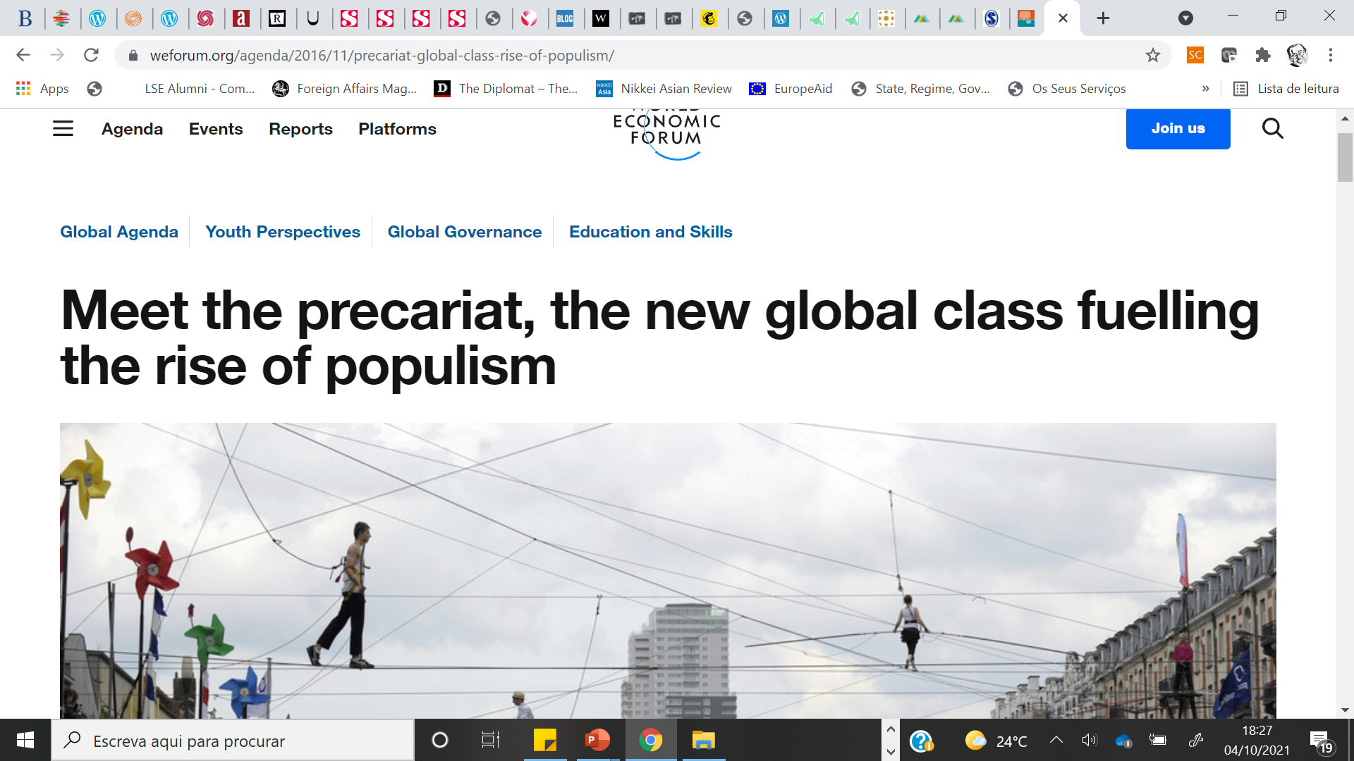

Slide 14
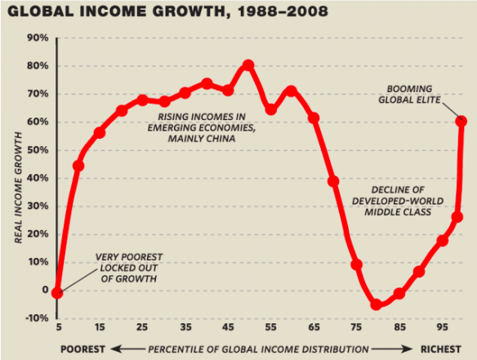

Slide 15
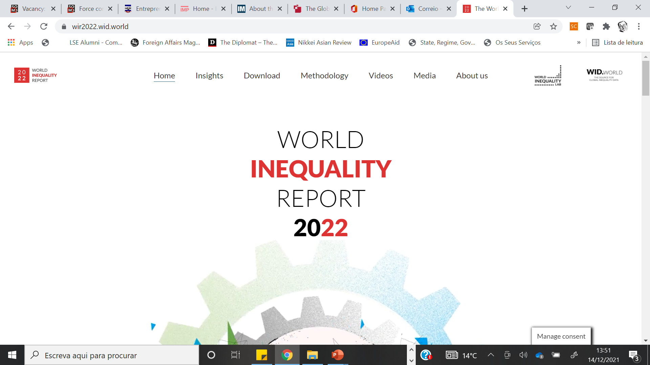

Slide 20
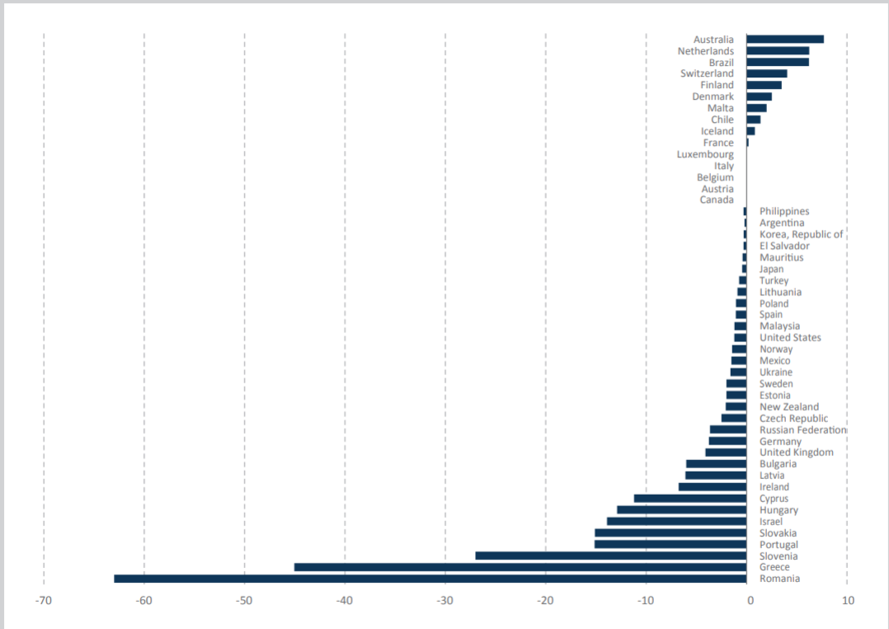
Collective bargaining is declining
Changes in collective bargaining coverage before and after the 2008-2012 economic crisis
ILO (2017) Trends in collective bargaining coverage: stability, erosion or decline?

Slide 21
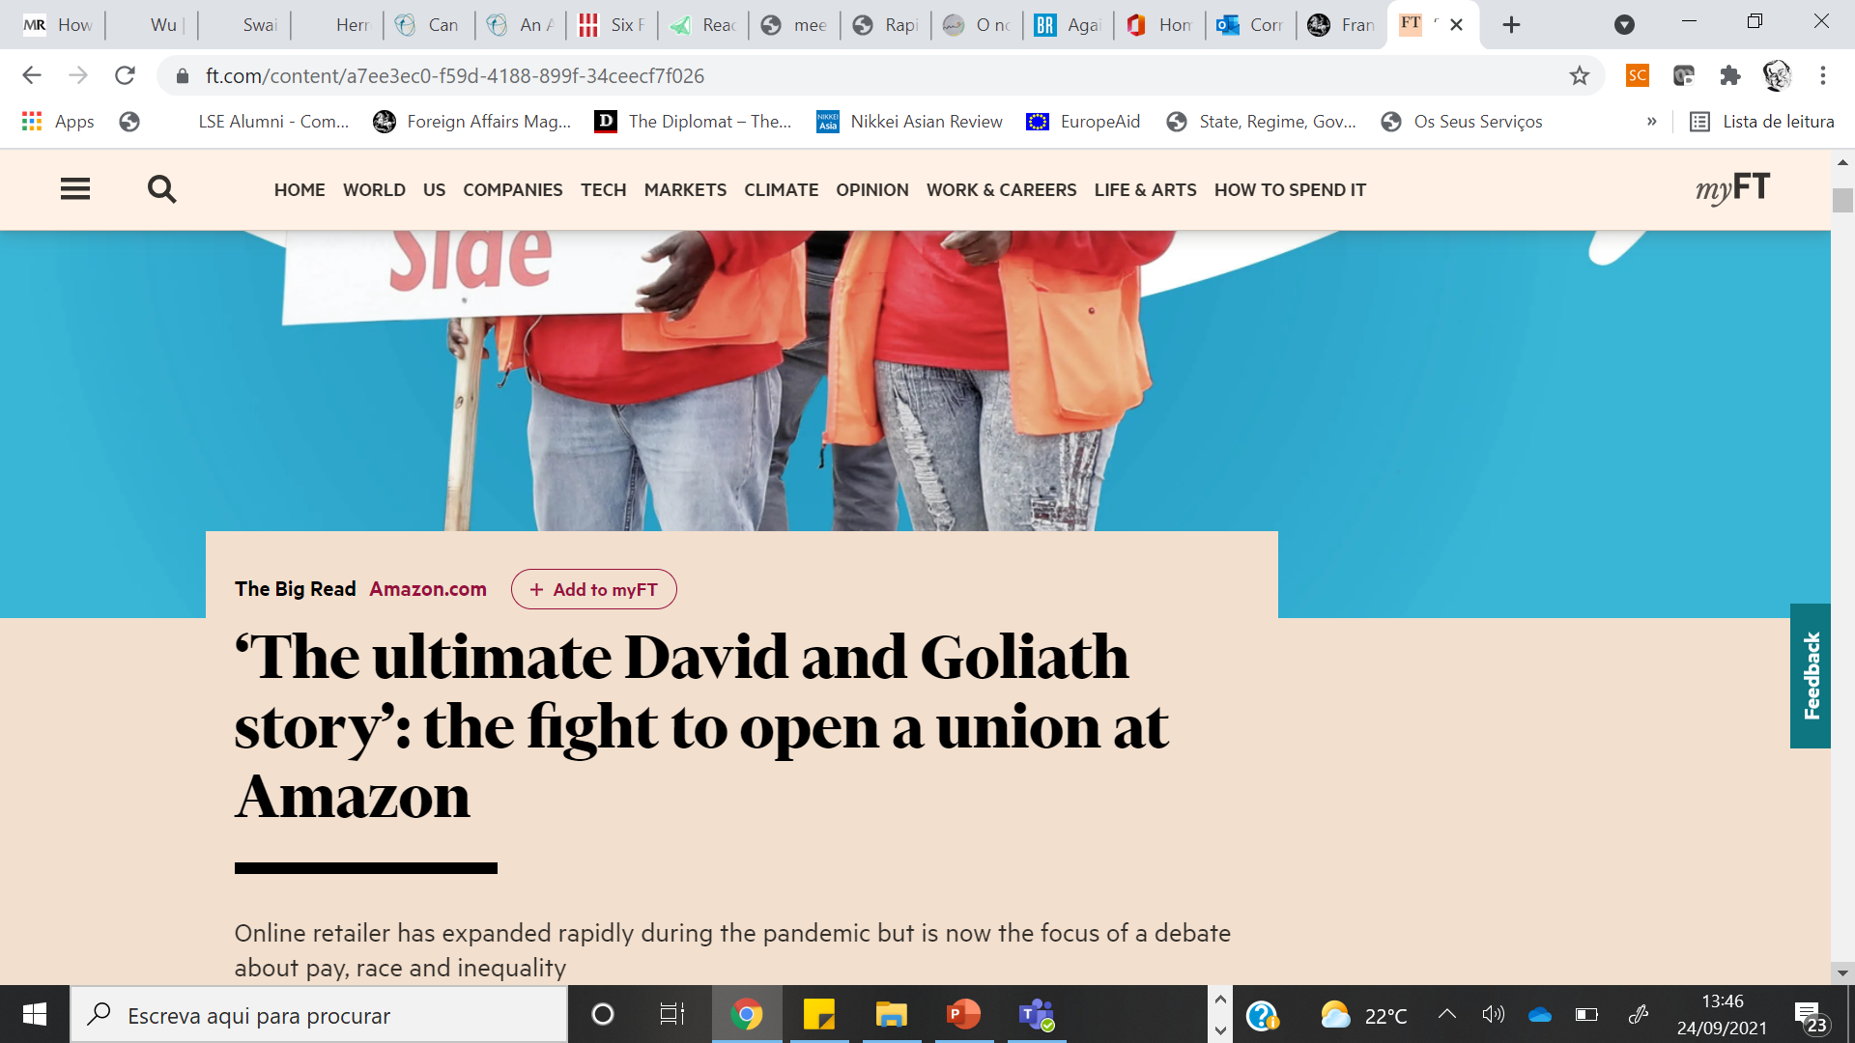

Slide 22

BBC,
11th September 2019

Slide 23
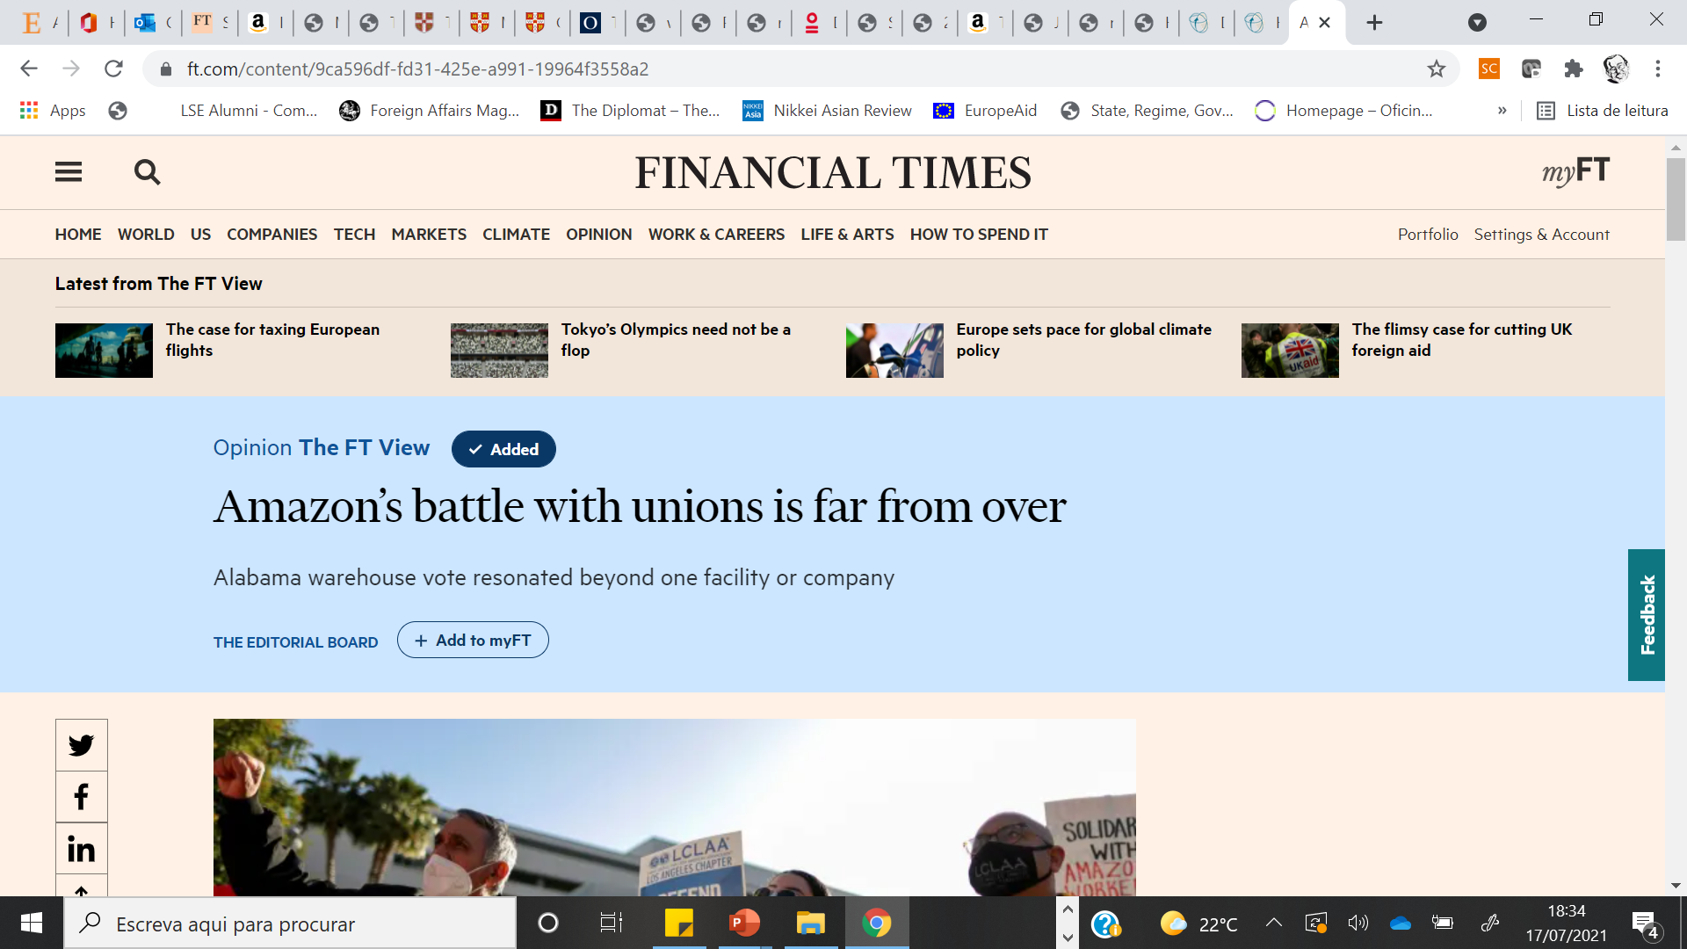

Slide 24
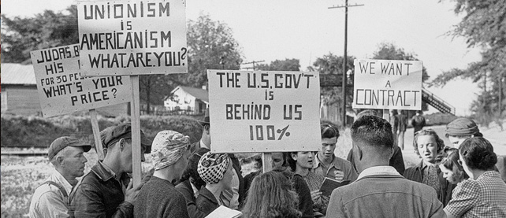

Slide 25
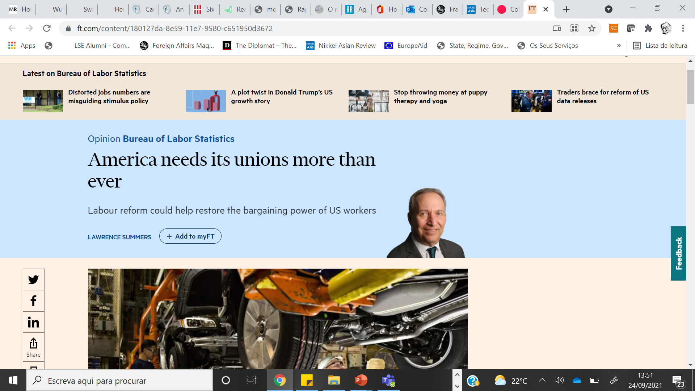

Slide 26
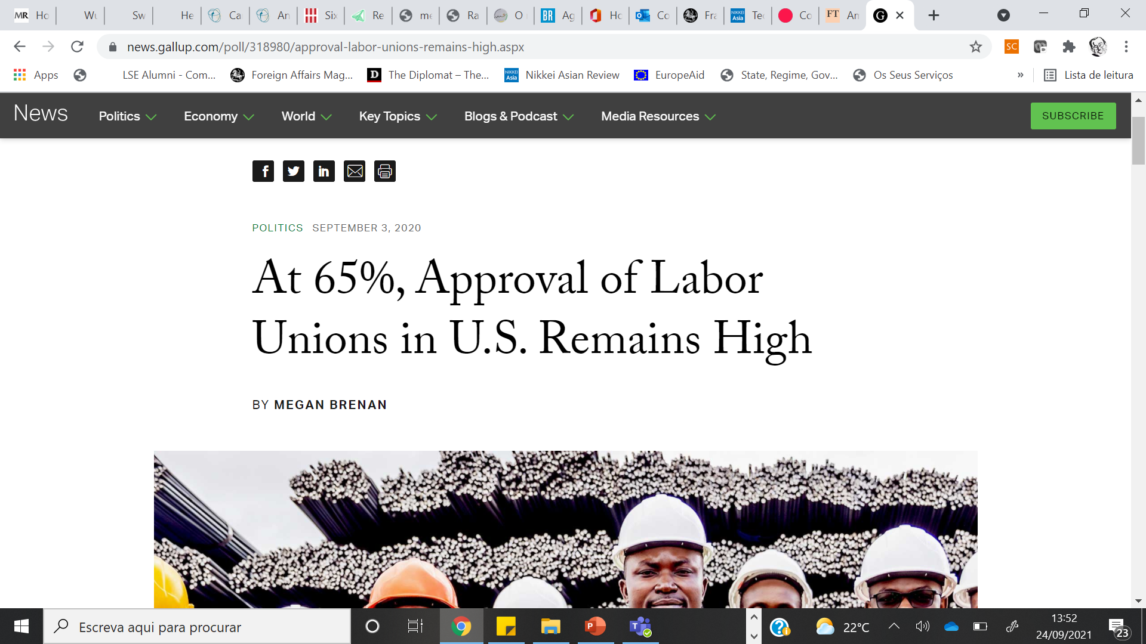

Slide 27
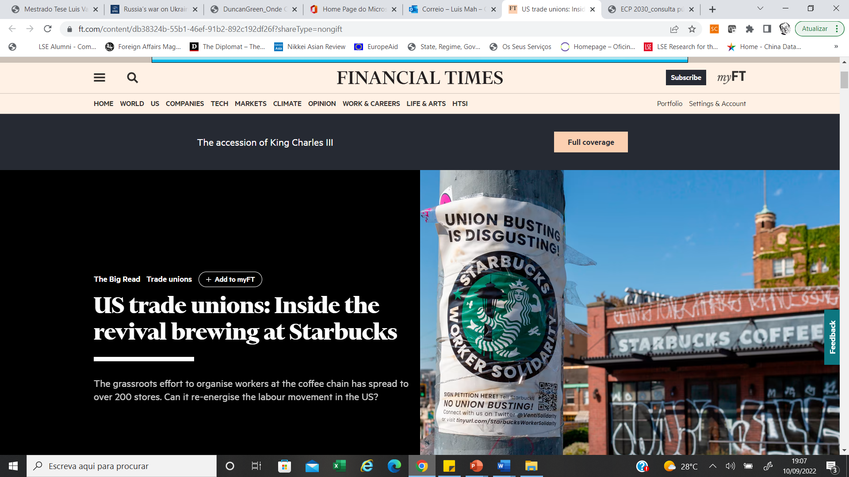

Slide 28
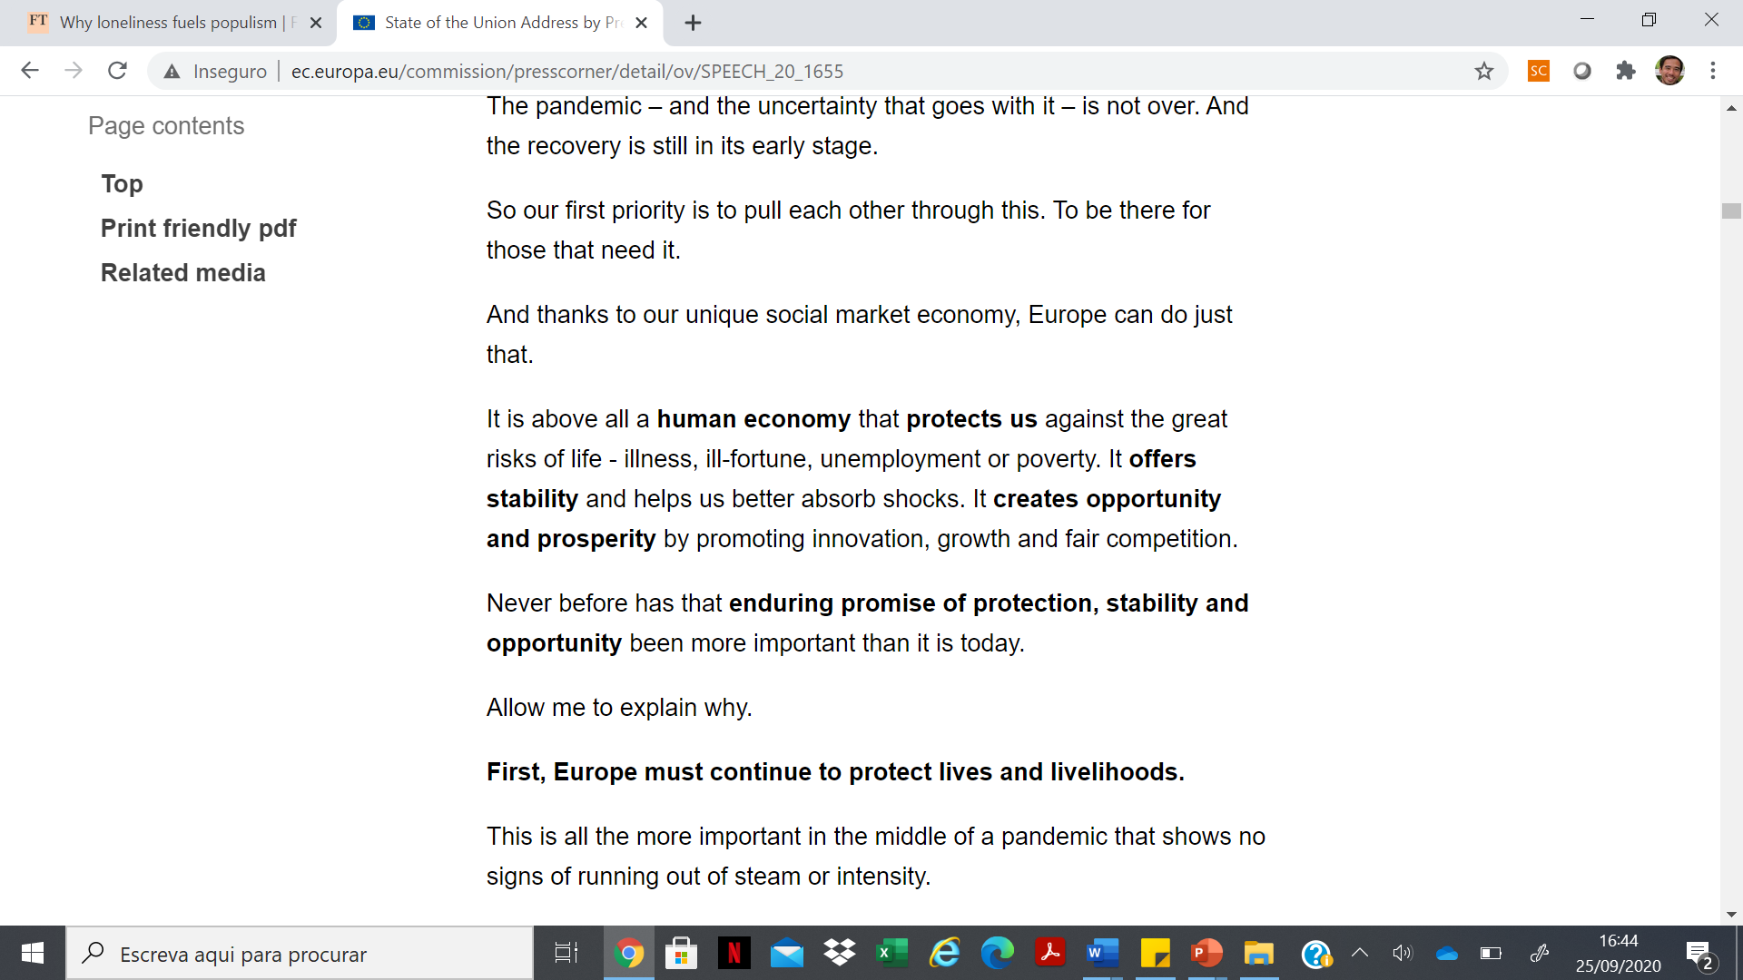

Slide 29
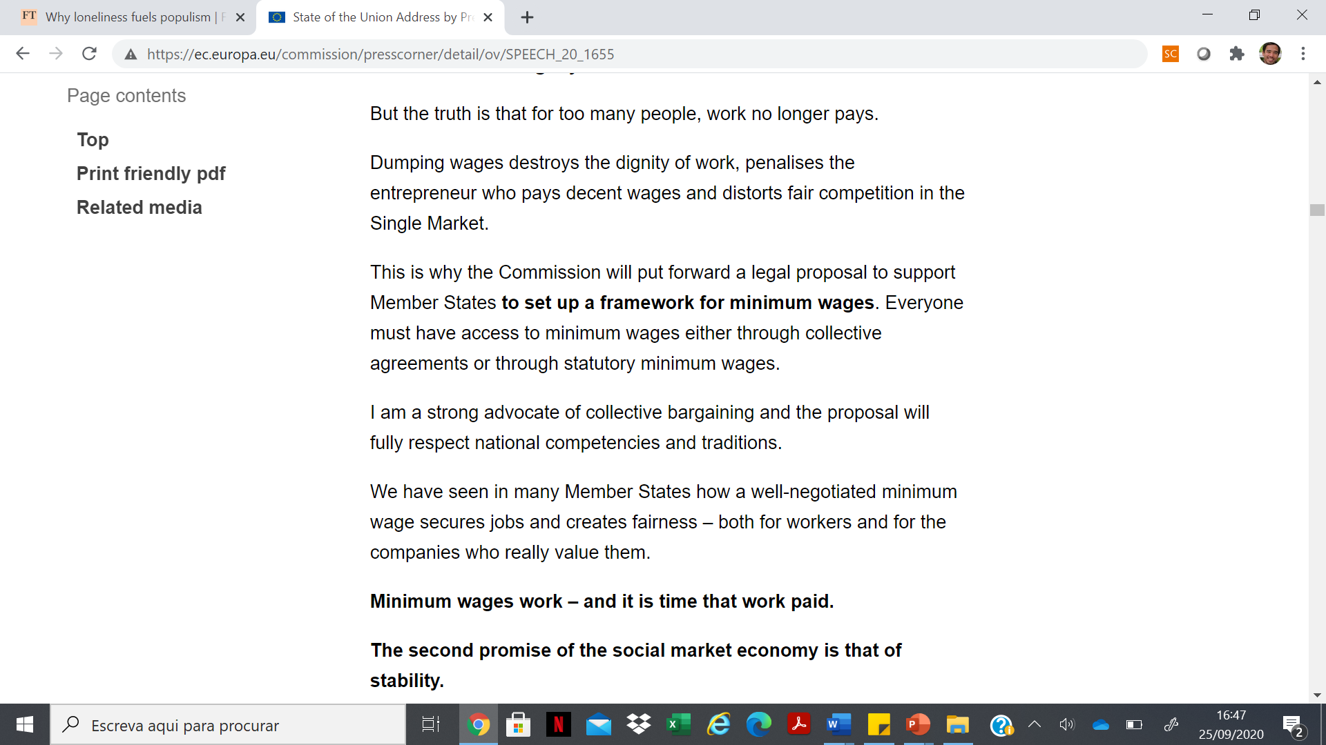

Slide 30
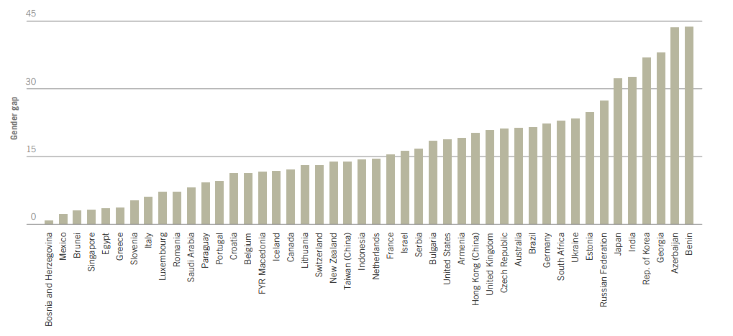
Gender pay gap in selected countries
ILO Global wage report 2016/2017

Slide 31
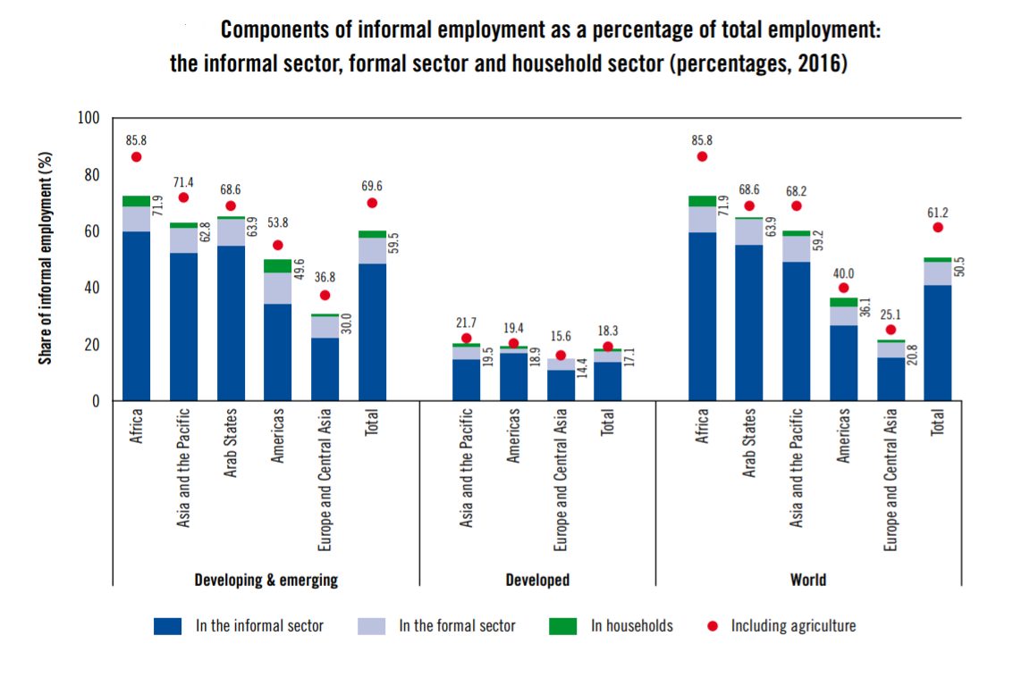
High and persistent informality
Source: ILO (2018) Women and men in the informal economy: A statistical picture

Slide 32
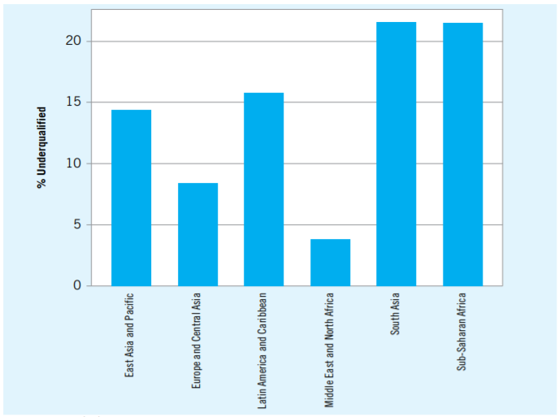
Skills shortages, especially in some regions
Percentage of workers under-skilled for available jobs (by region)
Source: ILO (2019) Skills and jobs mismatches in low and middle income countries

Slide 33

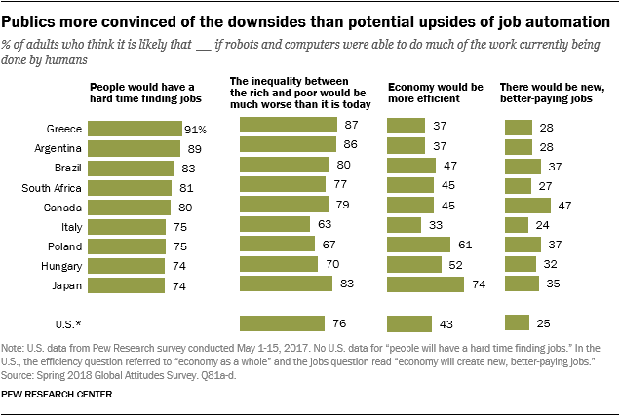

Slide 34
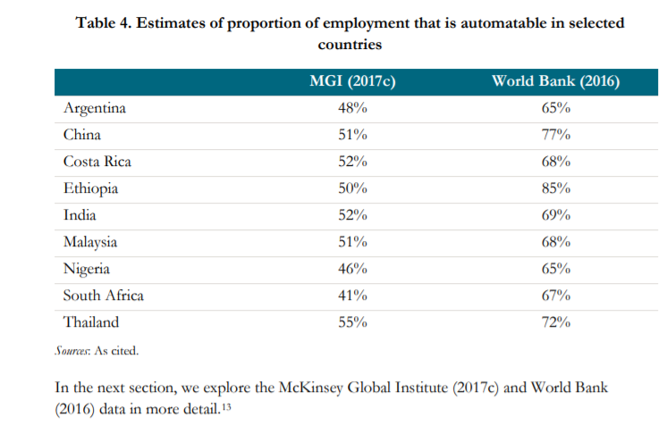
In developing countries
World Bank estimated in 2016 – 1.8 billion jobs or 2/3 of jobs in developing countries were already automatable!
Indonesia – 20,000 tollroad operators, an illustrative case
Source:Schlogl and Sumner, 2018

Slide 35
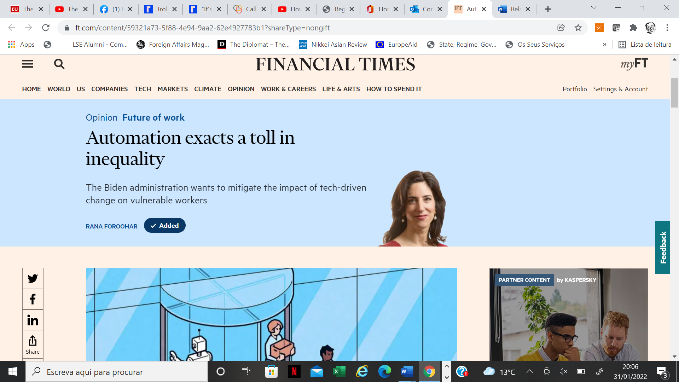

Slide 36
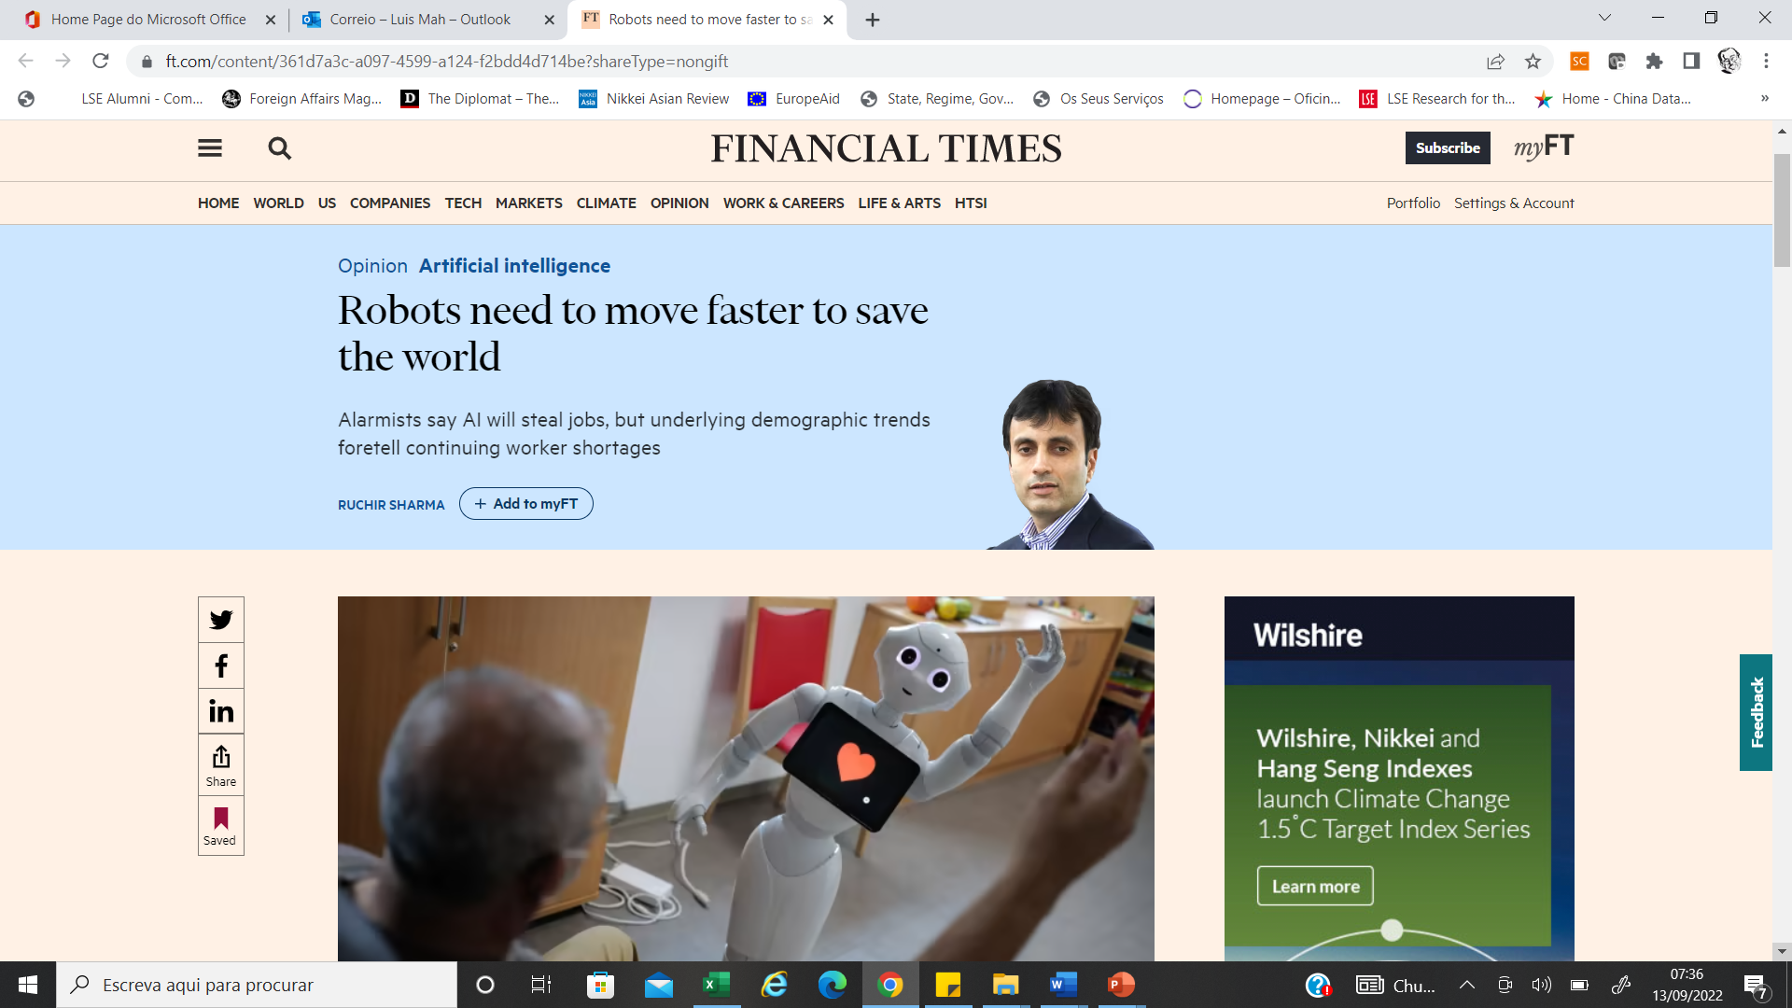

Slide 37
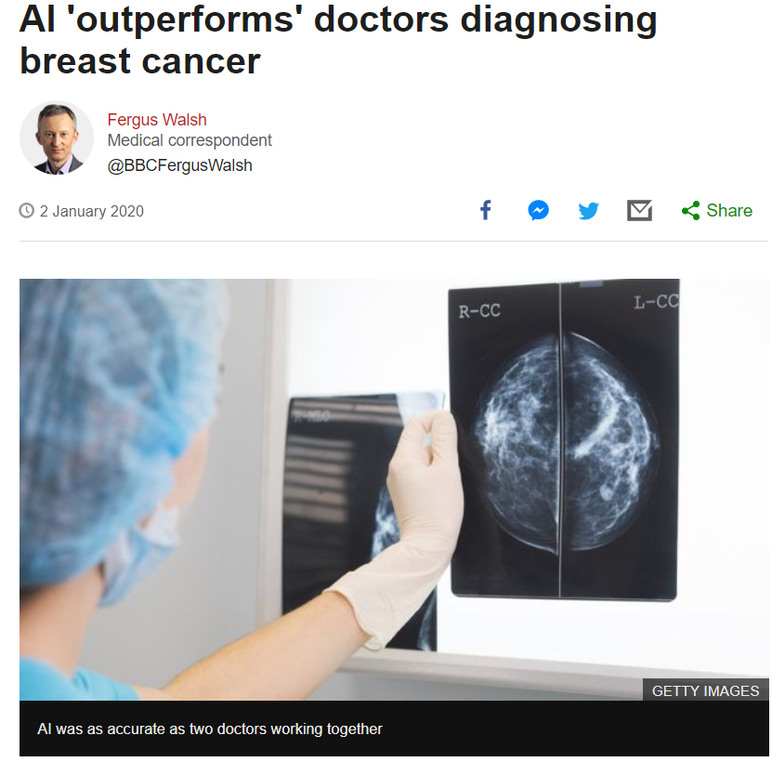
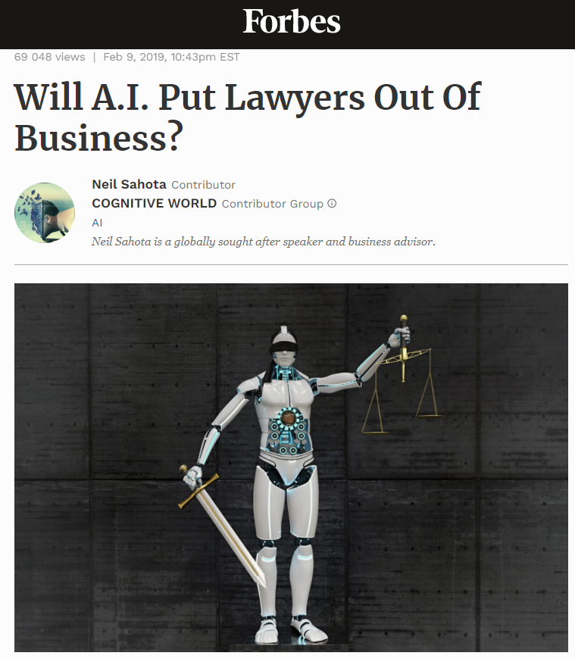
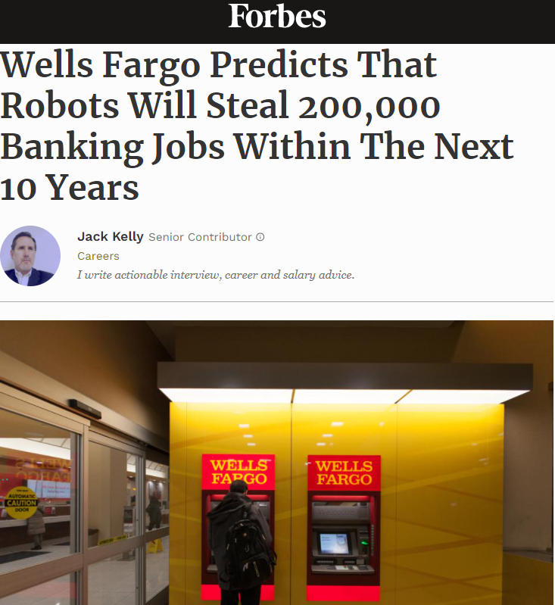
Coming for the upper classes (?)

Slide 38
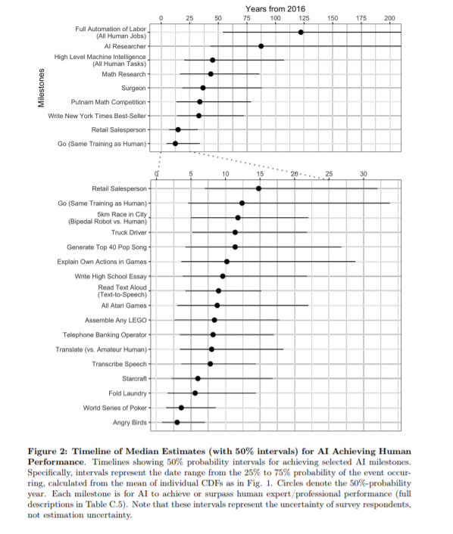
This time is different
SourceGrace et al., 2017

Slide 39
